Slide 1

Best way To Recruit!
“CKI OR GO HOME!”
–Jafar Malaka
2012-2013 CDCKI Membership Development and Education Committee

Slide 2
Keep in Mind To…
Smile!
Be friendly ☺
Be excited
Avoid CKI Lingo
Keep it short and sweet
Keep it as personal as possible (Reason you joined)

Slide 3
Most Common Approach: Speech
Prepare short speech before hand
Once you have one memorized, you can tweak it, depending where you are
Perfect for Recruitment Events (Info Tables)
Have an attention grabber
Talking to guys: Talk about something manly (Clean up horse poop)
Talking to girls: Teddy Bear Project
Ask: “Were you in Key Club in HS?” or “Ever heard of Kiwanis or Key Club?”

Slide 4
What You Can Include in Your Speech: Our Tenents
Service
Talk about our future/upcoming service projects
Senior Prom
Invite them to our next project
Talk about your positive experiences at past service projects
ACTS, Senior Center

Slide 5
What You Can Include in Your Speech: Our Tenets
Fellowship
Tell them of our past events (Hayride, Movies, school visits etc.)
Tell them of your new close friendships that you made thru the club & how that makes us unique
Invite them to our next event and Meeting
Leadership
Opportunities within our club
Committees
President/VP/Sec/Treasurer

Slide 6
Reason Why You Joined
What Would You Say?
This is something very important that can help us either get the potential member or not
Examples from Officers
Practice with the person next to you
Help each other with ideas
Share in 5 Minutes

Slide 7
What you need to know about Info Tables:
Talk loudly
This when your speech comes in!
Short amount of time to talk
Recognize when someone is interested
Look at their facial expressions
If you notice they are not interested, cut your speech short, give them our contact info and tell them to contact us when they are ready

Slide 8
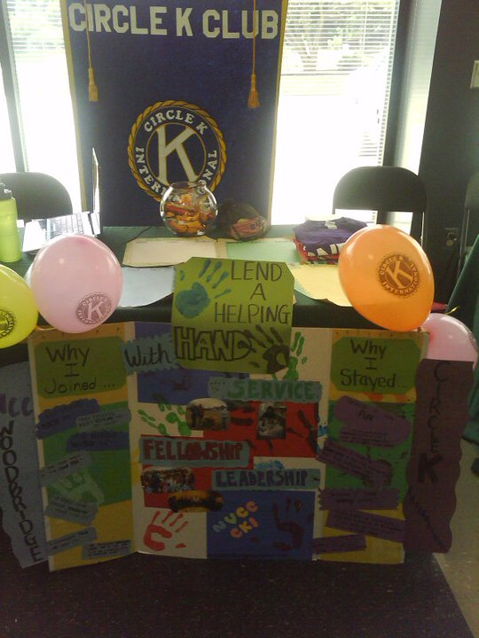
What you need to know about Info Tables:
If they are interested have them sign up for:
Contact info online
Upcoming events
Either interest meeting

Slide 9
What you need to know about Info Tables:
Empty Table???
Have your friendly face on
Go up to people and ask if you can talk to them for a minute
Bribe them (Candy, Food)

